Slide 1
CSE477
VLSI Digital Circuits
Fall 2002
Lecture 01: Introduction
Mary Jane Irwin ( www.cse.psu.edu/~mji ) www.cse.psu.edu/~cg477
[Adapted from Rabaey’s Digital Integrated Circuits, ©2002, J. Rabaey et al.]
Notes:
Other handouts
In class quiz
Course information sheet
To handout next time
Course schedule with due dates
HW#1
Project Description

Slide 2
Course Contents
Introduction to digital integrated circuits
  CMOS devices and manufacturing technology. CMOS logic gates and their layout. Propagation delay, noise margins, and power dissipation. Combinational (e.g., arithmetic) and sequential circuit design. Memory design.
Course goals
  Ability to design and implement CMOS digital circuits and optimize them with respect to different constraints: size (cost), speed, power dissipation, and reliability
Course prerequisites
  EE 310. Electronic Circuit Design
  CSE 471. Logic Design of Digital Systems

Slide 3
Course Administration
Instructor: Mary Jane Irwin mji@cse.psu.edu www.cse.psu.edu/~mji 227 Pond Lab Office Hrs: M 13:30-14:45 & R 9:30-10:45
TA: Vijay Degalahal degalaha@cse.psu.edu 225 Pond Lab Office Hrs: W & R 17:30 to 19:30 in 101 Pond
Labs: Accounts on 101 Pond Lab machines
URL: www.cse.psu.edu/~cg477
Text: Digital Integrated Circuits, 2nd Edition Rabaey et. al., ©2002 (prerelease of the first nine chapters at the Penn State Bookstore) Lecture slides (pdf) – on the web
Notes:
computer accounts are automatic, if have never had an account in CSE I will have (or soon have) a listing of userids/passwords.
seating chart – assignment for Thursday – xerox copy of your photo ID
pick a seat for the semester and sit there (or nearby) for rest of semester
room size -

Slide 4
Grading Information
Grade determinates
  Midterm Exam ~25%
    Wednesday, October 16th , 20:15 to 22:15, 260 Willard
  Final Exam ~25%
    Monday, December 16th, 10:10 to noon, Location TBD
  Homeworks/Lab Assignments (5) ~20%
    Due at the beginning of class (or, if submitted electronically, by 17:00 on the due date). No late assignments will be accepted.
  Design Project (teams of ~2) ~25%
  In-class pop quizzes ~ 5%
Please let me know about exam conflicts ASAP
Grades will be posted on the course homepage
  Must submit email request for change of grade after discussions with the TA (Homeworks/Lab Assignments) or instructor (Exams)
  December 10th deadline for filing grade corrections; no requests for grade changes will be accepted after this date
Notes:
Note: evening midterm exam
Design intensive class – with semester design project

Slide 5
Background from CSE471 and EE310
Basic circuit theory
  resistance, capacitance, inductance
  MOS gate characteristics
Hardware description language
  VHDL or verilog
Use of modern EDA tools
  simulation, synthesis, validation (Synopsys)
  schematic capture tools (LogicWorks)
Logic design
  logical minimization, FSMs, component design
Notes:
What you should ALREADY KNOW

Slide 6
Course Structure
Design and tool intensive class
  Micromagic (MMI) “max” and “sue” for layout
    Online documentation and tutorials
  HSPICE for circuit simulation
Lectures:
  2 weeks on the CMOS inverter
  3 weeks on static and dynamic CMOS gates
  2 weeks on C, R, and L effects
  2 week on sequential CMOS circuits
  2 weeks on design of datapath structures
  2 weeks on memory design
  1 week on design for test, margining, scaling, trends
  1 week exams
Notes:
if you have never used a Unix system - you have that to learn as well!

Slide 7
“Executives might make the final decisions about what would be produced, but engineers would provide most of the ideas for new products. After all, engineers were the people who really knew the state of the art and who were therefore best equipped to prophesy changes in it.”
The Soul of a New Machine, Kidder, pg 35

Slide 8
Transistor Revolution
Transistor –Bardeen (Bell Labs) in 1947
Bipolar transistor – Schockley in 1949
First bipolar digital logic gate – Harris in 1956
First monolithic IC – Jack Kilby in 1959
First commercial IC logic gates – Fairchild 1960
TTL – 1962 into the 1990’s
ECL – 1974 into the 1980’s
Notes:
TTL had a higher integration density than ECL
Power – puts an upper limit on the number of gates that can be reliably integrated on a single die

Slide 9
MOSFET Technology
MOSFET transistor - Lilienfeld (Canada) in 1925 and Heil (England) in 1935
CMOS – 1960’s, but plagued with manufacturing problems
PMOS in 1960’s (calculators)
NMOS in 1970’s (4004, 8080) – for speed
CMOS in 1980’s – preferred MOSFET technology because of power benefits
BiCMOS, Gallium-Arsenide, Silicon-Germanium
SOI, Copper-Low K, …
Notes:
PMOS came first because of fab problems with NMOS
NMOS next because of fab problems with CMOS (NMOS has speed advantage over PMOS due to carrier mobility)

Slide 10
Moore’s Law
In 1965, Gordon Moore predicted that the number of transistors that can be integrated on a die would double every 18 to 14 months (i.e., grow exponentially with time).
Amazingly visionary – million transistor/chip barrier was crossed in the 1980’s.
  2300 transistors, 1 MHz clock (Intel 4004) - 1971
  16 Million transistors (Ultra Sparc III)
  42 Million, 2 GHz clock (Intel P4) - 2001
  140 Million transistor (HP PA-8500)

Slide 11
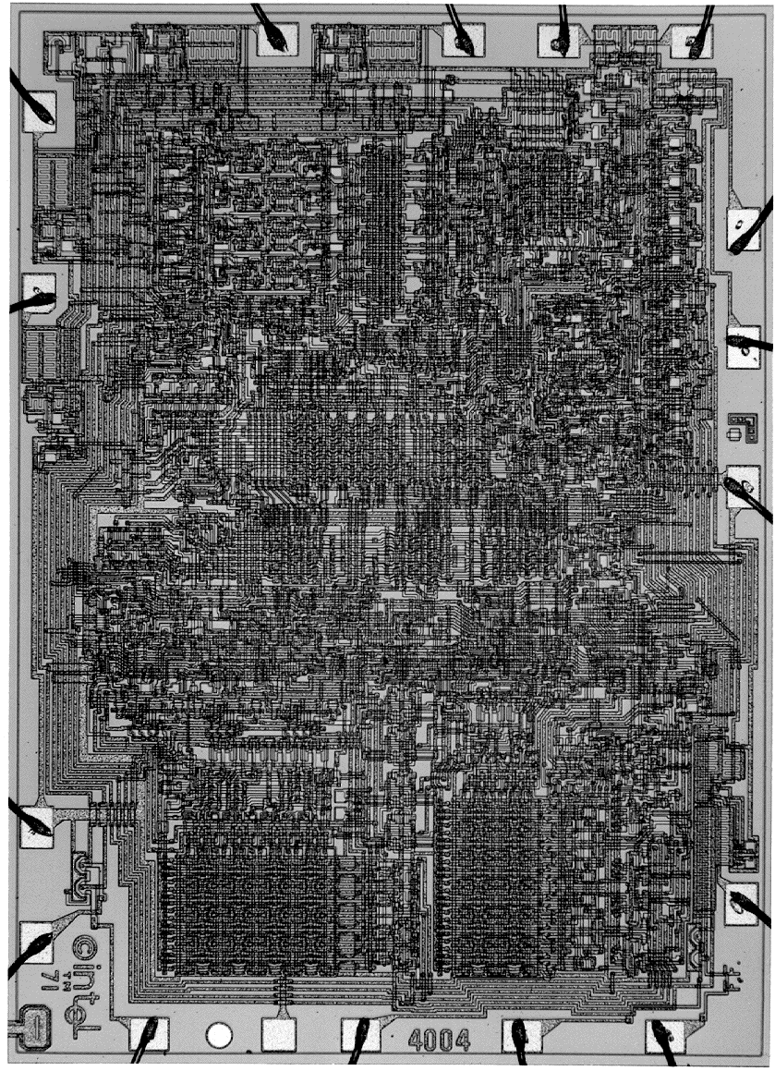
Intel 4004 Microprocessor
Notes:
introduced in 1971 versus 8086 introduced in 1978
1 MHz clock rate 10 MHz clock rate
5volt VDD (?) 5volt VDD
10 micron (?) 3 micron
5K transistors (?) 29K transistors

Slide 12
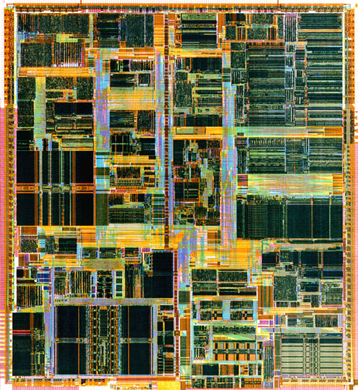
Intel Pentium (IV) Microprocessor
Notes:
P5 introduced in 1994 versus P6 (Pentium Pro) in 1996
75 to 100 MHz clock rate 150 to 200 MHz clock rate
91 mm**2 196 mm**2
3.3M transistors 5.5M transistors
(1M in cache) (external cache)
0.35 micron 0.35 micron
4 layers metal 4 layers metal
3.3volt VDD 3.3volt VDD
>20W typical power dissipation
387 pins

Slide 13
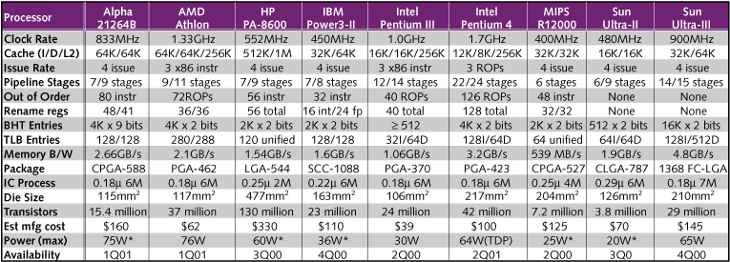
State-of-the Art: Lead Microprocessors

Slide 14
Moore’s Law in Microprocessors
Transistors on lead microprocessors double every 2 years
1000
2X growth in 1.96 years!
100
10
P6
Pentium® proc
1
486
Transistors (MT)
386
0.1
286
8085
8086
0.01
8080
8008
4004
0.001
1970
1980
1990
2000
2010
Year
Courtesy, Intel

Slide 15
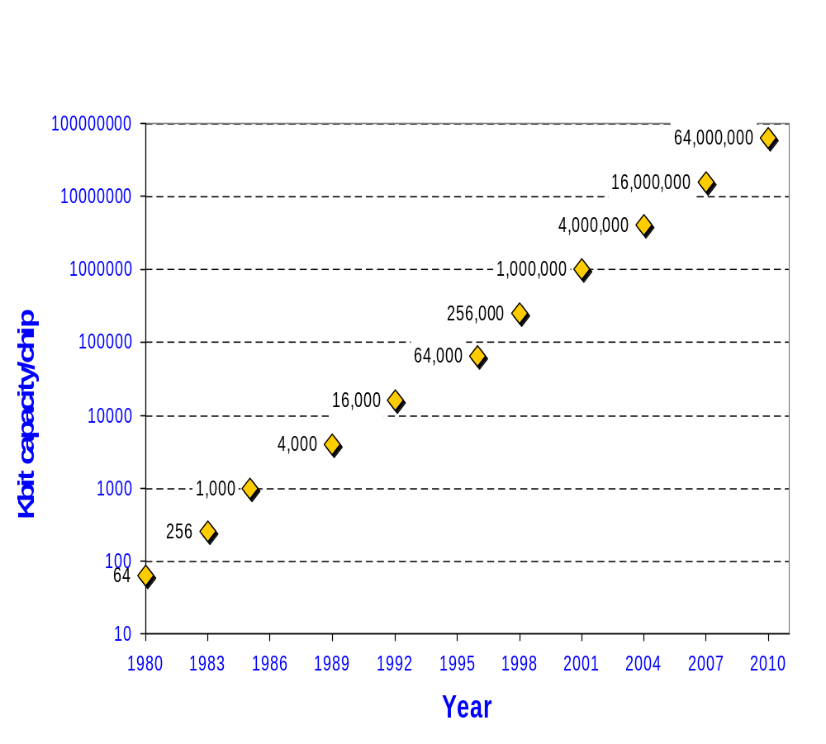
Evolution in DRAM Chip Capacity
human memory
human DNA
4X growth every 3 years!
0.07 μm
0.1 μm
0.13 μm
book
0.18-0.25 μm
0.35-0.4 μm
0.5-0.6 μm
encyclopedia
2 hrs CD audio
30 sec HDTV
0.7-0.8 μm
1.0-1.2 μm
1.6-2.4 μm
page

Slide 16
Die Size Growth
Die size grows by 14% to satisfy Moore’s Law
100
P6
486
Pentium ® proc
10
386
Die size (mm)
286
8080
8086
8085
~7% growth per year
8008
~2X growth in 10 years
4004
1
1970
1980
1990
2000
2010
Year
Courtesy, Intel

Slide 17
Clock Frequency
Lead microprocessors frequency doubles every 2 years
10000
1000
2X every 2 years
100
P6
Pentium ® proc
Frequency (Mhz)
486
10
8085
386
8086
286
1
8080
8008
4004
0.1
1970
1980
1990
2000
2010
Year
Courtesy, Intel
Notes:
Causes: shrinking feature size and increased pipelining

Slide 18
Power Dissipation
Lead Microprocessors power continues to increase
100
P6
Pentium ® proc
10
286
486
Power (Watts)
8086
386
8085
1
8080
8008
4004
0.1
1971
1974
1978
1985
1992
2000
Year
Power delivery and dissipation will be prohibitive
Courtesy, Intel

Slide 19
Power Density
10000
Rocket
Nozzle
1000
Nuclear
100
Reactor
Power Density (W/cm2)
8086
10
4004
Hot Plate
P6
8008
8085
386
Pentium® proc
8080
286
486
1
1970
1980
1990
2000
2010
Year
Power density too high to keep junctions at low temp
Courtesy, Intel

Slide 20
Design Productivity Trends
10,000
100,000
(M)
1,000
Logic Tr./Chip
10,000
Tr./Staff Month.
100
1,000
Complexity
10
58%/Yr. compounded
100
Complexity growth rate
Productivity
(K) Trans./Staff - Mo.
Logic Transistor per Chip
1
10
0.1
x
x
1
x
21%/Yr. compound
x
x
x
x
x
Productivity growth rate
0.01
0.1
0.001
0.01
1981
1983
1985
1987
1989
1991
1993
1995
1997
1999
2001
2003
2005
2007
2009
Complexity outpaces design productivity
Courtesy, ITRS Roadmap

Slide 21
Technology Directions: SIA Roadmap
Year | 1999 | 2002 | 2005 | 2008 | 2011 | 2014
Feature size (nm) | 180 | 130 | 100 | 70 | 50 | 35
Mtrans/cm² | 7 | 14-26 | 47 | 115 | 284 | 701
Chip size (mm²) | 170 | 170-214 | 235 | 269 | 308 | 354
Signal pins/chip | 768 | 1024 | 1024 | 1280 | 1408 | 1472
Clock rate (MHz) | 600 | 800 | 1100 | 1400 | 1800 | 2200
Wiring levels | 6-7 | 7-8 | 8-9 | 9 | 9-10 | 10
Power supply (V) | 1.8 | 1.5 | 1.2 | 0.9 | 0.6 | 0.6
High-perf power (W) | 90 | 130 | 160 | 170 | 174 | 183
Battery power (W) | 1.4 | 2.0 | 2.4 | 2.0 | 2.2 | 2.4
For Cost-Performance MPU (L1 on-chip SRAM cache; 32KB/1999 doubling every two years)
http://www.itrs.net/ntrs/publntrs.nsf

Slide 22
Why Scaling?
Technology shrinks by ~0.7 per generation
With every generation can integrate 2x more functions on a chip; chip cost does not increase significantly
Cost of a function decreases by 2x
But …
  How to design chips with more and more functions?
  Design engineering population does not double every two years…
Hence, a need for more efficient design methods
  Exploit different levels of abstraction

Slide 23
Design Abstraction Levels
SYSTEM
MODULE
+
GATE
CIRCUIT
CIRCUIT
V_{in}
V_{in}
V_{out}
V_{out}
DEVICE
G
S
D
n+
n+

Slide 24
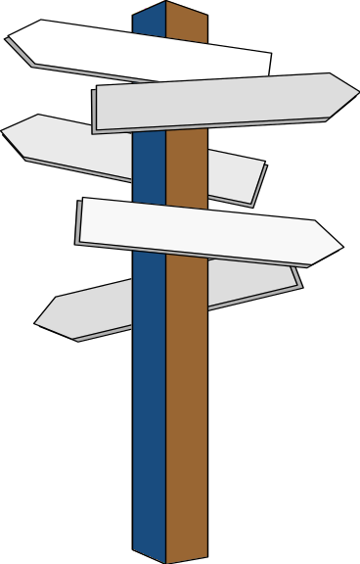
Major Design Challenges
Microscopic issues
  ultra-high speeds
  power dissipation and supply rail drop
  growing importance of interconnect
  noise, crosstalk
  reliability, manufacturability
  clock distribution
Macroscopic issues
  time-to-market
  design complexity (millions of gates)
  high levels of abstractions
  reuse and IP, portability
  systems on a chip (SoC)
  tool interoperability
Year | Tech. | Complexity | Frequency | 3 Yr. Design Staff Size | Staff Costs
1997 | 0.35 | 13 M Tr. | 400 MHz | 210 | $90 M
1998 | 0.25 | 20 M Tr. | 500 MHz | 270 | $120 M
1999 | 0.18 | 32 M Tr. | 600 MHz | 360 | $160 M
2002 | 0.13 | 130 M Tr. | 800 MHz | 800 | $360 M
Notes:
Staffing costs computed at $150K/staff year (in 1997 dollars)

Slide 25
Next Lecture and Reminders
Next lecture
  Design metrics
    Reading assignment – 1.3
Reminders
  Hands on max tutorial
    Thursday evening from 7:00 to 9:00 pm in 101 Pond Lab
  HW1 due September 10th
  Evening midterm exam scheduled
    Wednesday, October 16th , 20:15 to 22:15, 260 Willard
    Please let me know ASAP (via email) if you have a conflict

